Slide 1
How to Use Local Extensions for Member Institutions of a Network Zone consortia
Yoel Kortick
Senior Librarian

Slide 2

Agenda
Introduction
Our sample records
Adding the local extensions in the Metadata Editor
The effects of the local extensions in Alma
The effects of the local extensions in Primo

Slide 3
Introduction

Slide 4
Introduction
It is possible for each Member Institution of a consortia to add and edit local extensions to bibliographic records which are maintained in the Network Zone.
Local extensions provide a means for each Member Institution to enter local information.
When doing so the original and ongoing updated versions of the Network Zone record are not affected for other Member Institutions of the consortia.

Slide 5
Introduction
For MARC21 the local extension may be added in the following fields: 77X/78X, 09X, 59X, 69X, and 9XX fields. Local information should be added using the "Add Local Field" option in the MD Editor.

Slide 6
Our sample records

Slide 7
Our sample records
In the example here we have a network zone and three member institutions:
Member / Network | Name | Inst. Code
Network | Ex Libris University Consortium | EXLDEMO2_INST
Member | Alma University | EXLDEV1_INST
Member | Open University | EXLDEMO3_INST
Member | University of Knowledge | EXLDEMO1_INST

Slide 8

Our sample records
Network Zone
Ex Libris University Consortium
Member Institution
Alma University
Member Institution
Open University
Member Institution
University of Knowledge

Slide 9
Our sample records
Title "Gloria Steinem women's liberation leader" is in the network zone with two bibliographic records.
One is catalogued as a physical record, and one is catalogued as an electronic record.
The electronic record is not only in the Network Zone but also linked to the community zone

Slide 10
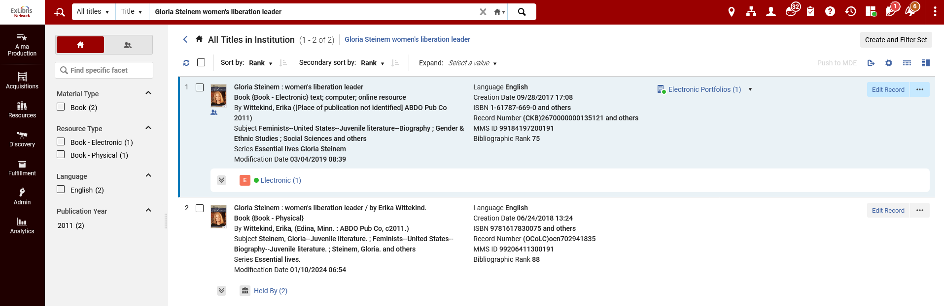
Our sample records
Searching Network Zone institution tab
Electronic record is linked to CZ
One is catalogued as electronic, and one is catalogued as physical

Slide 11
Our sample records
The physical record is "held by" both Alma University and University of Knowledge
The electronic record is "available for" via "Group Settings" the group "Alma University and University of Knowledge". This group includes (as the name suggests) the two Member Institutions "Alma University" and "University of Knowledge"

Slide 12
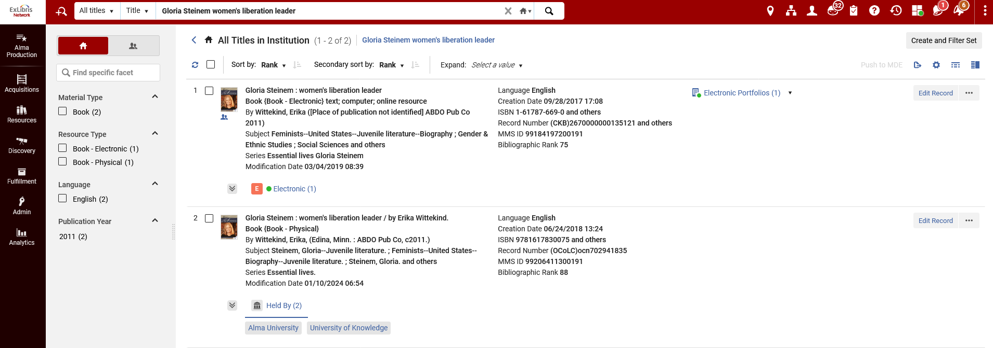
Our sample records
An All Titles search in institution tab of Network Zone shows the physical record held by Alma University and University of Knowledge

Slide 13
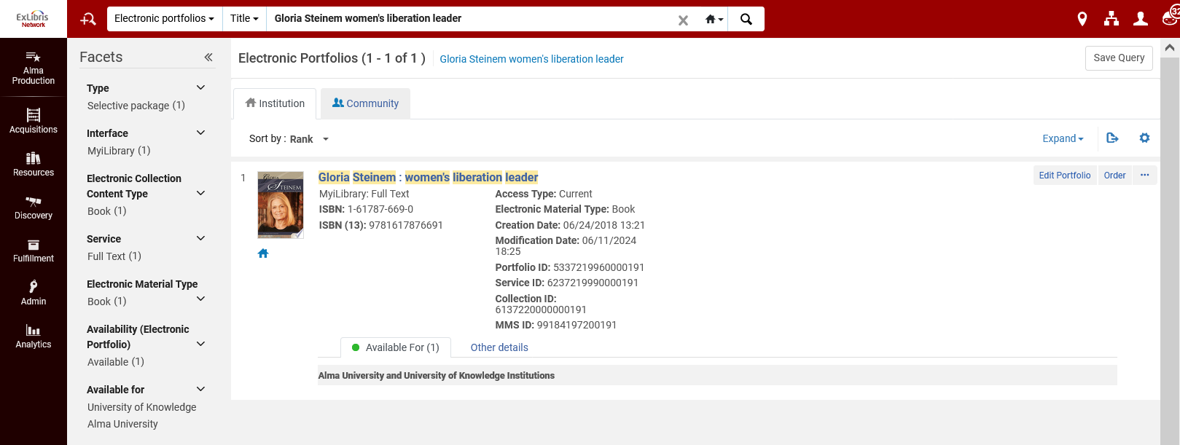
Our sample records
An Electronic Portfolios search in institution tab of Network Zone shows the electronic record available for Alma University and University of Knowledge

Slide 14
Adding the local extensions in the Metadata Editor

Slide 15
Adding the local extensions in the Metadata Editor
Member institution "University of knowledge" wants to add local extensions as follows:
  093 $$a 613.365.248 YLK
  690 $$a Gender studies PhD

Slide 16
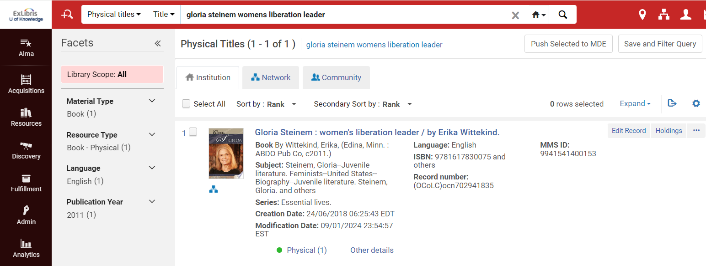
Adding the local extensions in the Metadata Editor
In Member Institution "University of Knowledge" the record with the physical inventory is retrieved and edited

Slide 17
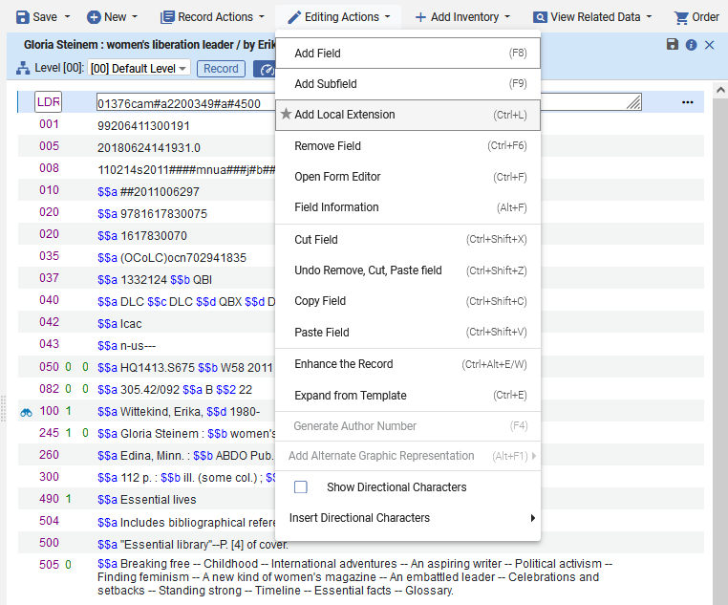
Adding the local extensions in the Metadata Editor
In the Metadata Editor we will choose option "Edit > Add Local Extension" or shortcut key CTRL + L

Slide 18
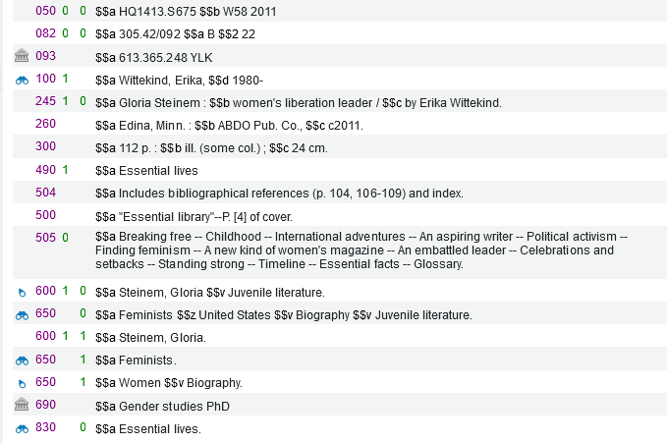
Adding the local extensions in the Metadata Editor
The local fields get added with a sign that it is an institutional field (local extension of the Member Institution) and not part of the network record

Slide 19
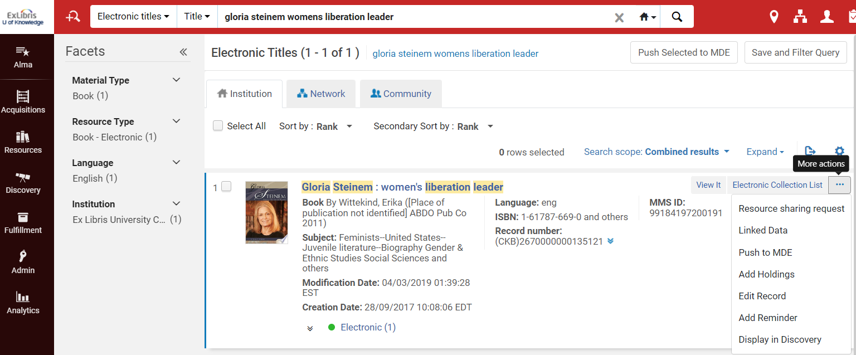
Adding the local extensions in the Metadata Editor
In University of knowledge the record with the electronic inventory (linked to CZ) will be retrieved and edited

Slide 20
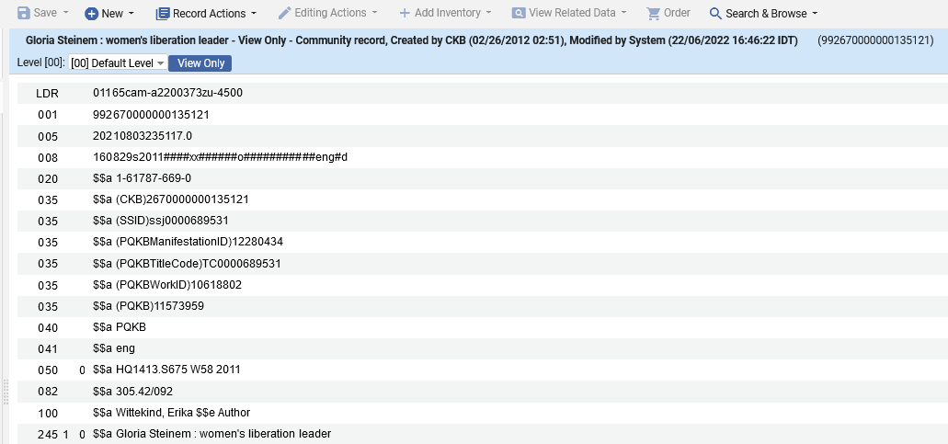
Adding the local extensions in the Metadata Editor
We see that because this is a community zone record it cannot be edited here (as previously explained in this presentation)
It is a Community Zone record, so it is "View Only"

Slide 21
The effects of the local extensions in Alma

Slide 22
The effects of the local extensions in Alma
The local extensions are visible only to the Member Institution which added them

Slide 23
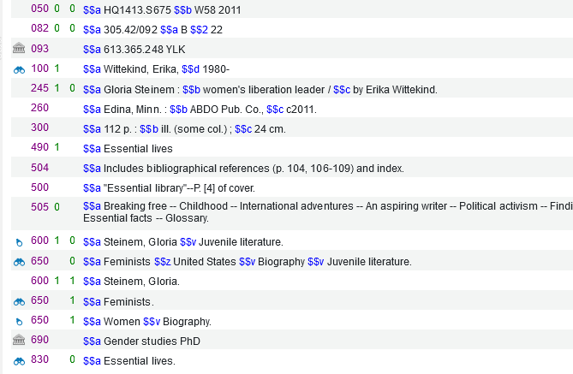
The effects of the local extensions in Alma
Here is the Network Zone record viewed in Member Institution University of Knowledge in the Metadata Editor
University of Knowledge sees the local extensions it added

Slide 24
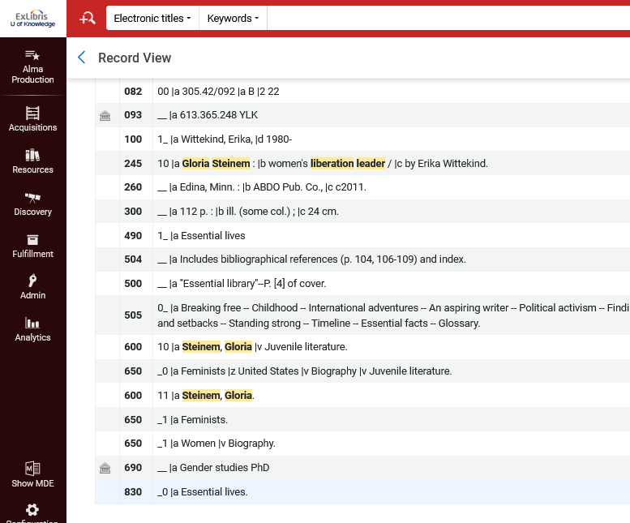
The effects of the local extensions in Alma
Here is the Network Zone record viewed in Member Institution University of Knowledge in the Repository search results
University of Knowledge sees the local extensions it added

Slide 25
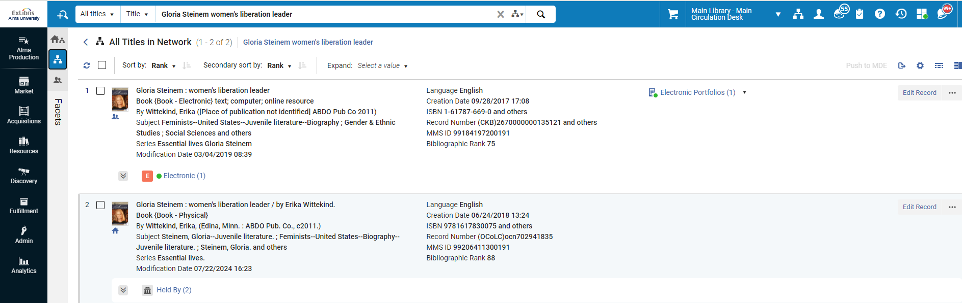
The effects of the local extensions in Alma
Now we will look at the Network Zone record in Member Institution Alma University

Slide 26
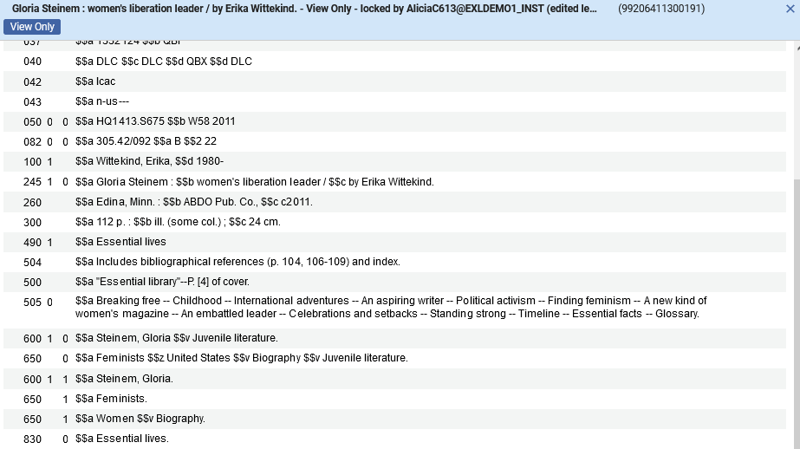
The effects of the local extensions in Alma
Here is the Network Zone record in Member Institution Alma University in the Metadata Editor
Alma University does not see the local extensions which were added by University of Knowledge

Slide 27
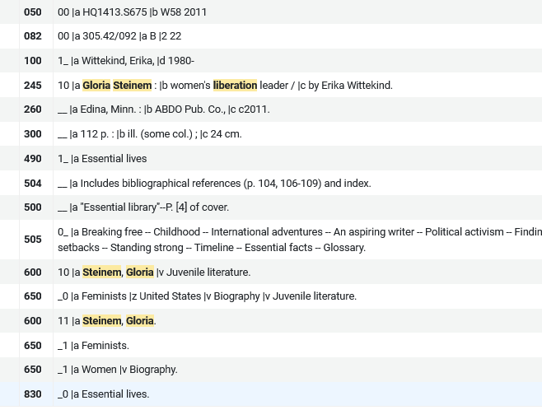
The effects of the local extensions in Alma
Here is the Network Zone record in Member Institution Alma University in the repository search results
Alma University does not see the local extensions which were added by University of Knowledge

Slide 28
The effects of the local extensions in Alma
In University of Knowledge "Configuration > Resources > Search Configuration > Search Indexes" we have enabled the 093 local call number and the 69X local subject for both simple search and advanced search

Slide 29
The effects of the local extensions in Alma
In University of Knowledge "Configuration > Resources > Search Configuration > Customize Indexes labels" we have customized the 093 local call number and called it "U. of Knowledge call number (093)"

Slide 30
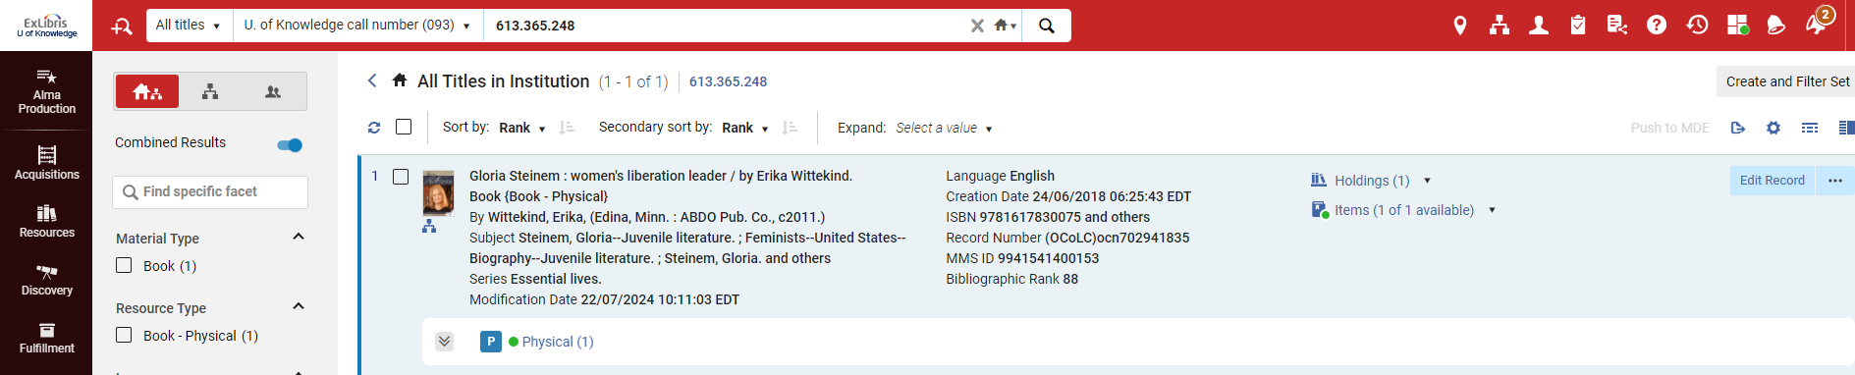
The effects of the local extensions in Alma
Now in University of Knowledge the staff user can search by "U. of Knowledge call number (093)"
Here in University of Knowledge institution tab we find the record with the local extension by searching the local extension field.

Slide 31
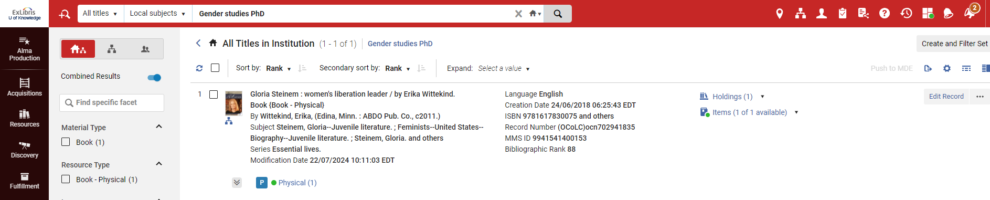
The effects of the local extensions in Alma
We can also find the local extension added to the 690 field, which by default is indexed in the ‘Local subjects" index
Here in University of Knowledge institution tab we find the record with the local extension by searching the local extension field.

Slide 32
The effects of the local extensions in Primo

Slide 33
The effects of the local extensions in Primo
The bibliographic record which we have looked at here includes
  The two local extensions from University of Knowledge
  An indication that these local extensions "belong to" University of Knowledge.
These fields can then be displayed and indexed in Primo as desired

Slide 34
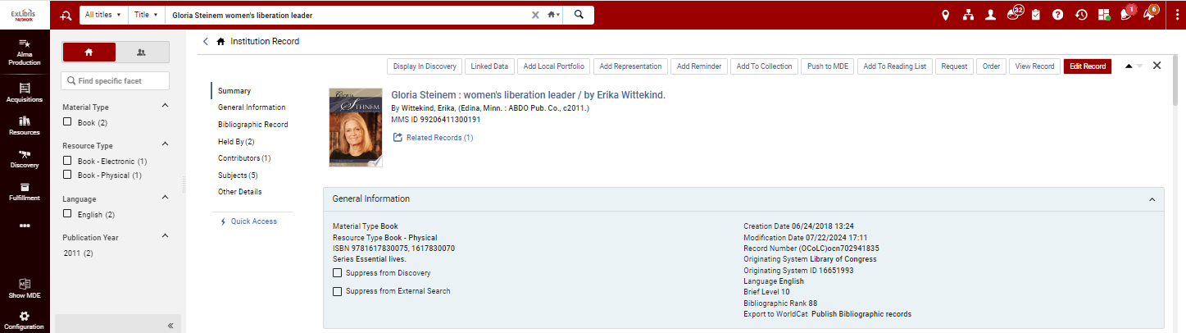
The effects of the local extensions in Primo
Let’s look at the published record to see how the local extensions appear “behind the senses”.
We are in the Network Institution
We will switch to “Other Details”

Slide 35
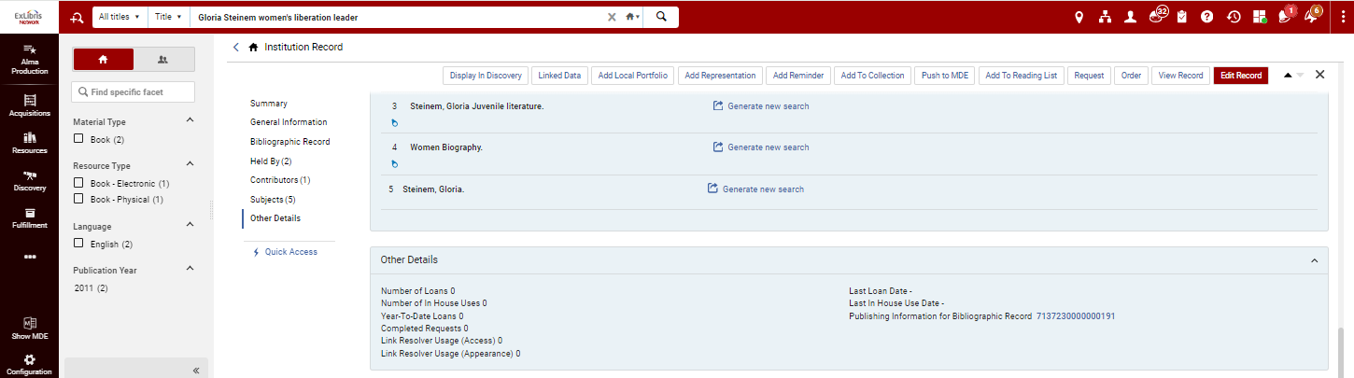
The effects of the local extensions in Primo
Let’s look at the published record to see how the local extensions appear “behind the senses”.
We will click the link for the publishing information

Slide 36
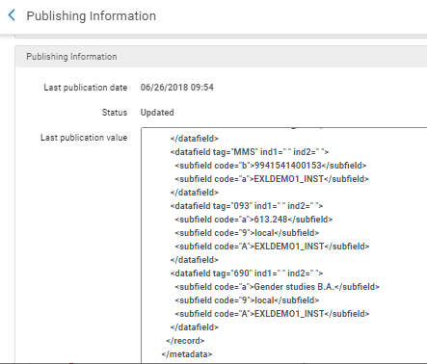
The effects of the local extensions in Primo
Here are the published local extension fields.
We can see that "behind the scenes" when a local extension field is created it gets
  a subfield 9 with text "local" which does not appear in Alma.
  A subfield A with the code of the institution which does not appear in Alma. (U of Knowledge is EXLDEMO1_INST)

Slide 37
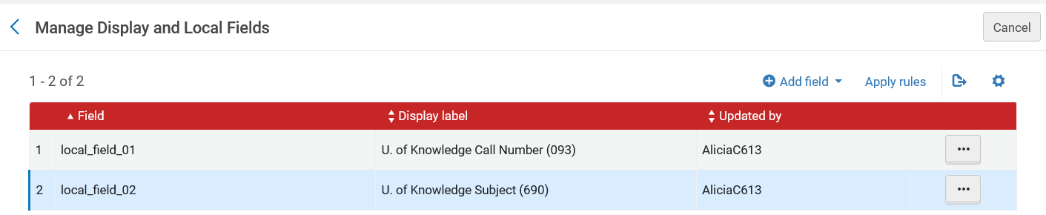
The effects of the local extensions in Primo
These two fields can be configured for search in Primo. Here is an example of the configuration in Primo VE.
In Member Institution "University of Knowledge" Go to "Discovery > Display Configuration > Manage display and local fields"
Do "Add Field > Add Local Field"

Slide 38
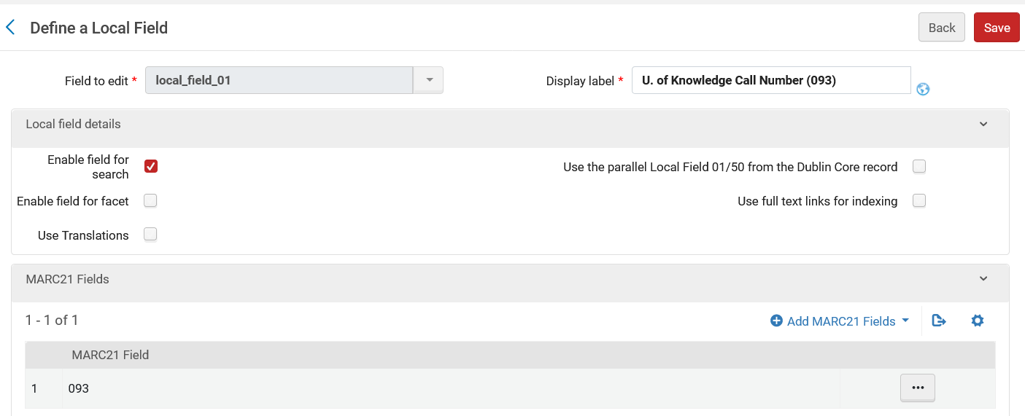
The effects of the local extensions in Primo
Here is local_field_01
Field will be searchable

Slide 39
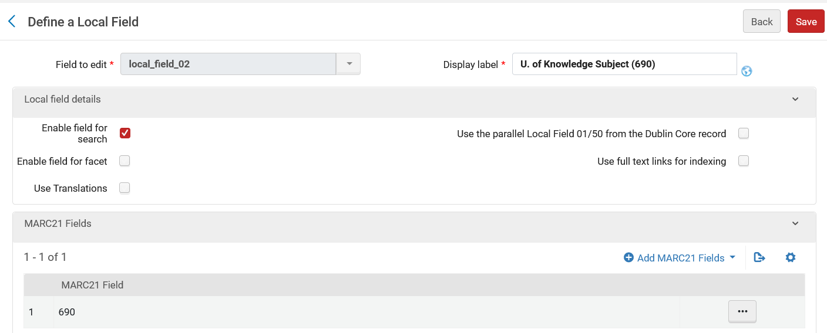
The effects of the local extensions in Primo
Here is local_field_02
Field will be searchable

Slide 40
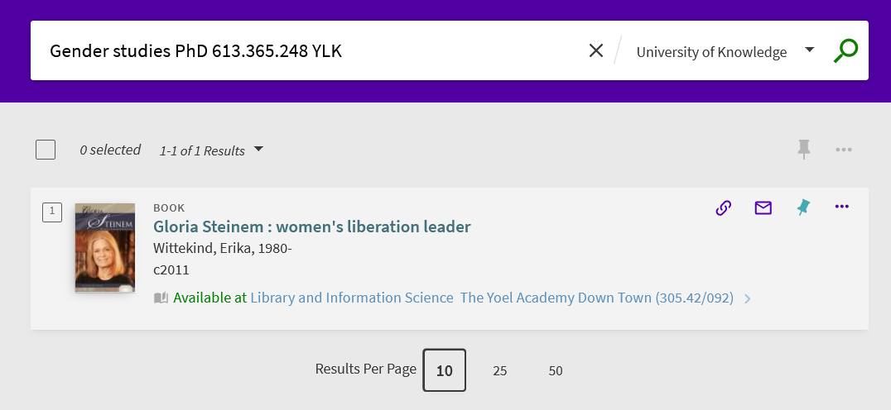
The effects of the local extensions in Primo
Searching Primo VE Member Institution "University of Knowledge" for data from the local extensions we find the record:

Slide 41
The effects of the local extensions in Primo
Now we will add these two fields for display in the "Details" section of Primo VE. This is done as follows:
In Member Institution "University of Knowledge" do: Alma menu > Discovery > Display Configuration > Configure Views
Choose desired view and edit it
Switch to "Full Record Services tab"
Configure the "Details" row.
Add the local fields
Move the local fields to desired place in list of fields

Slide 42
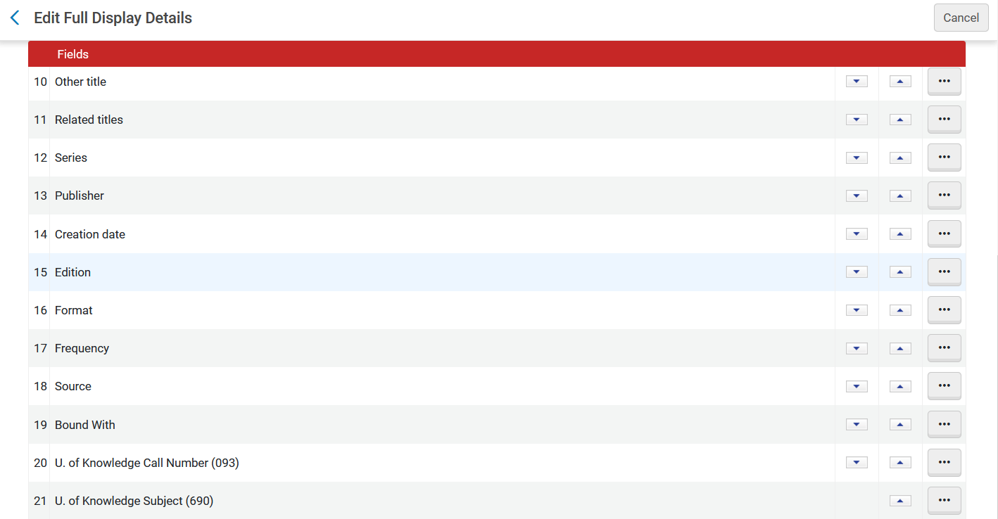
The effects of the local extensions in Primo
We have added the two fields to the bottom of the full display details.

Slide 43
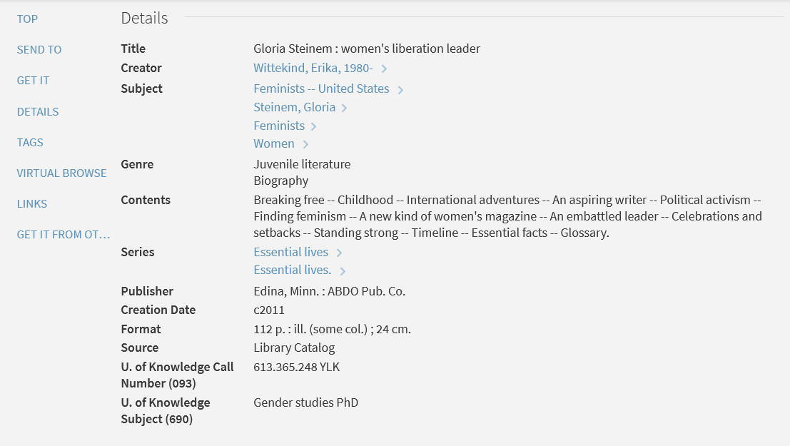
The effects of the local extensions in Primo
Now the local extensions appear in Primo VE Record Details

